Slide 1
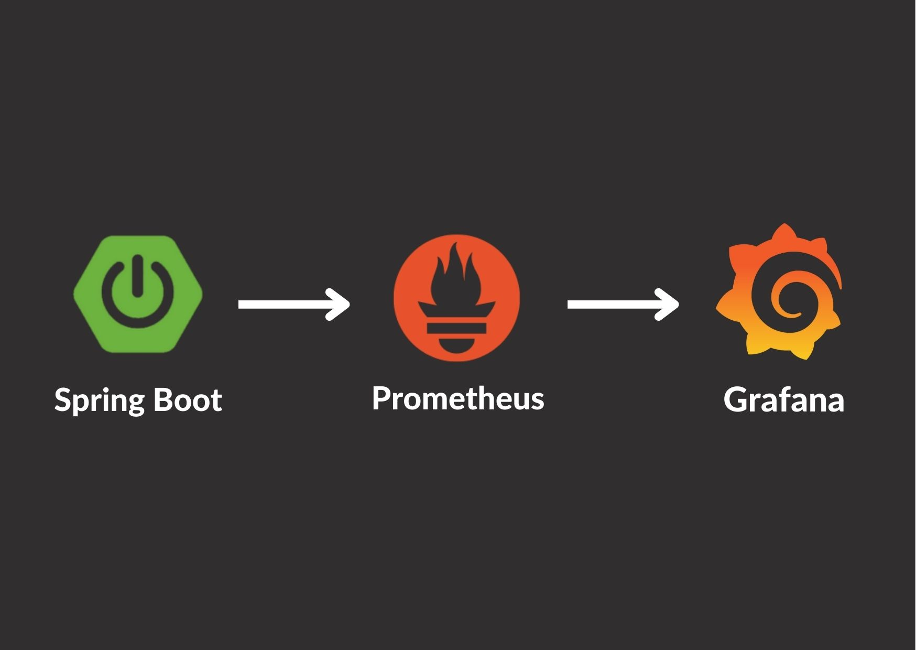
Spring Boot With Prometheus And Grafana
Submitted by:
Meera Javad
245217

Slide 2
Monitoring Spring Application
Performance monitoring is a critical aspect of any software application development and deployment.
It also helps identify issues that could negatively impact the performance of our application, such as slow page load times, high resource usage, and frequent crashes.
Spring Boot Actuator
Spring Boot Actuator is a sub-project of the Spring Boot Framework. It includes a number of additional features that help us to monitor and manage the Spring Boot application. It contains the actuator endpoints (the place where the resources live).

Slide 3
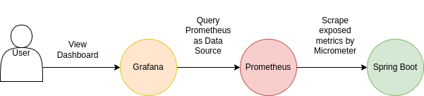
Monitoring System Tools
Typically, a monitoring system would have three core components which include;
A Metric Store – Time-series database. Like Prometheus, InfluxDB, TimescaleDB etc.
Dashboard for the visualization of data stored in the Database.(Grafana)
Applications that periodically supplies the Metric store with metrics data from the application’s local state.(Micrometer)

Slide 4
Prometheus
Prometheus is an open-source technology designed to provide monitoring and alerting functionality for cloud-native environments, including Kubernetes.
It can collect and store metrics as time-series data, recording information with a timestamp.
It uses PromQL, A flexible querying language that can leverage the multi-dimensional data model.

Slide 5
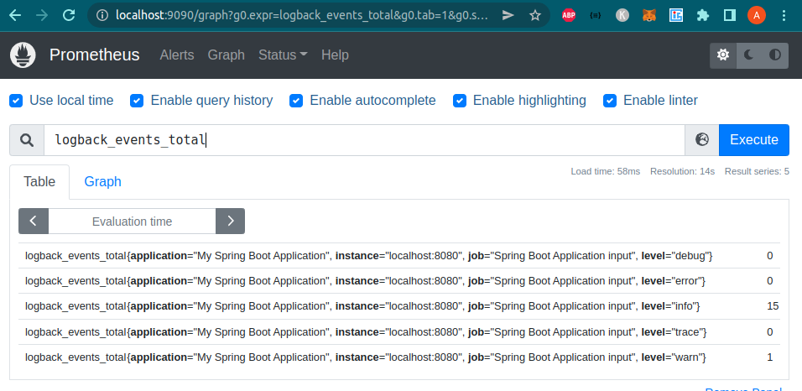

Slide 6
Grafana
Grafana is an open-source solution for running data analytics with the help of metrics that give us an insight into the complex infrastructure and massive amount of data that our services deal with, with the help of customizable dashboards.
The tool helps us study, analyze and monitor data over a period of time, technically called time series analytics.
It helps us track the user behavior, application behavior, frequency of errors popping up in production, pre-prod or any other environment, type of errors popping up and the contextual scenarios by providing relative data.

Slide 7
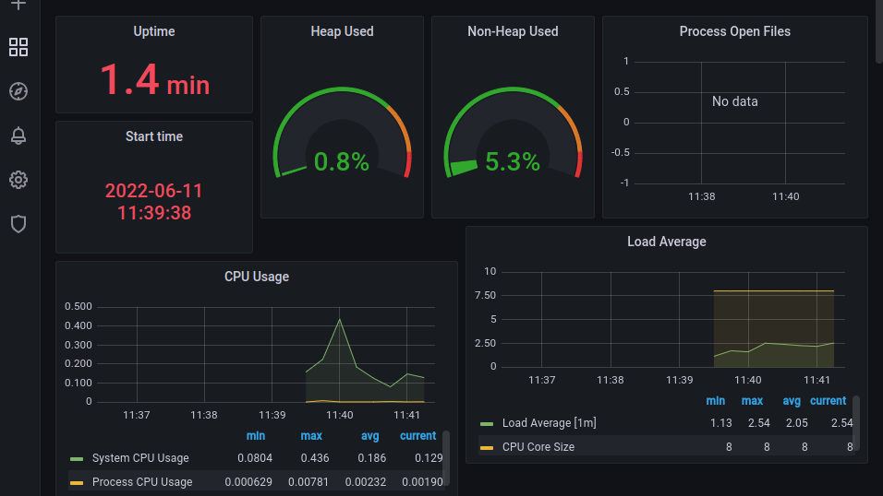

Slide 8
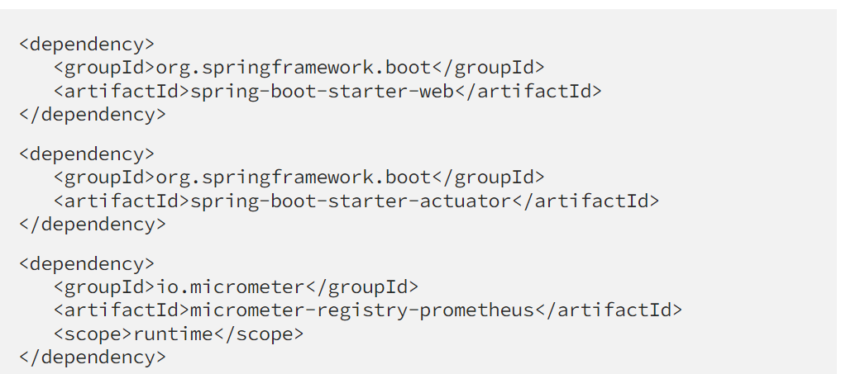
Spring boot app monitoring

Slide 9
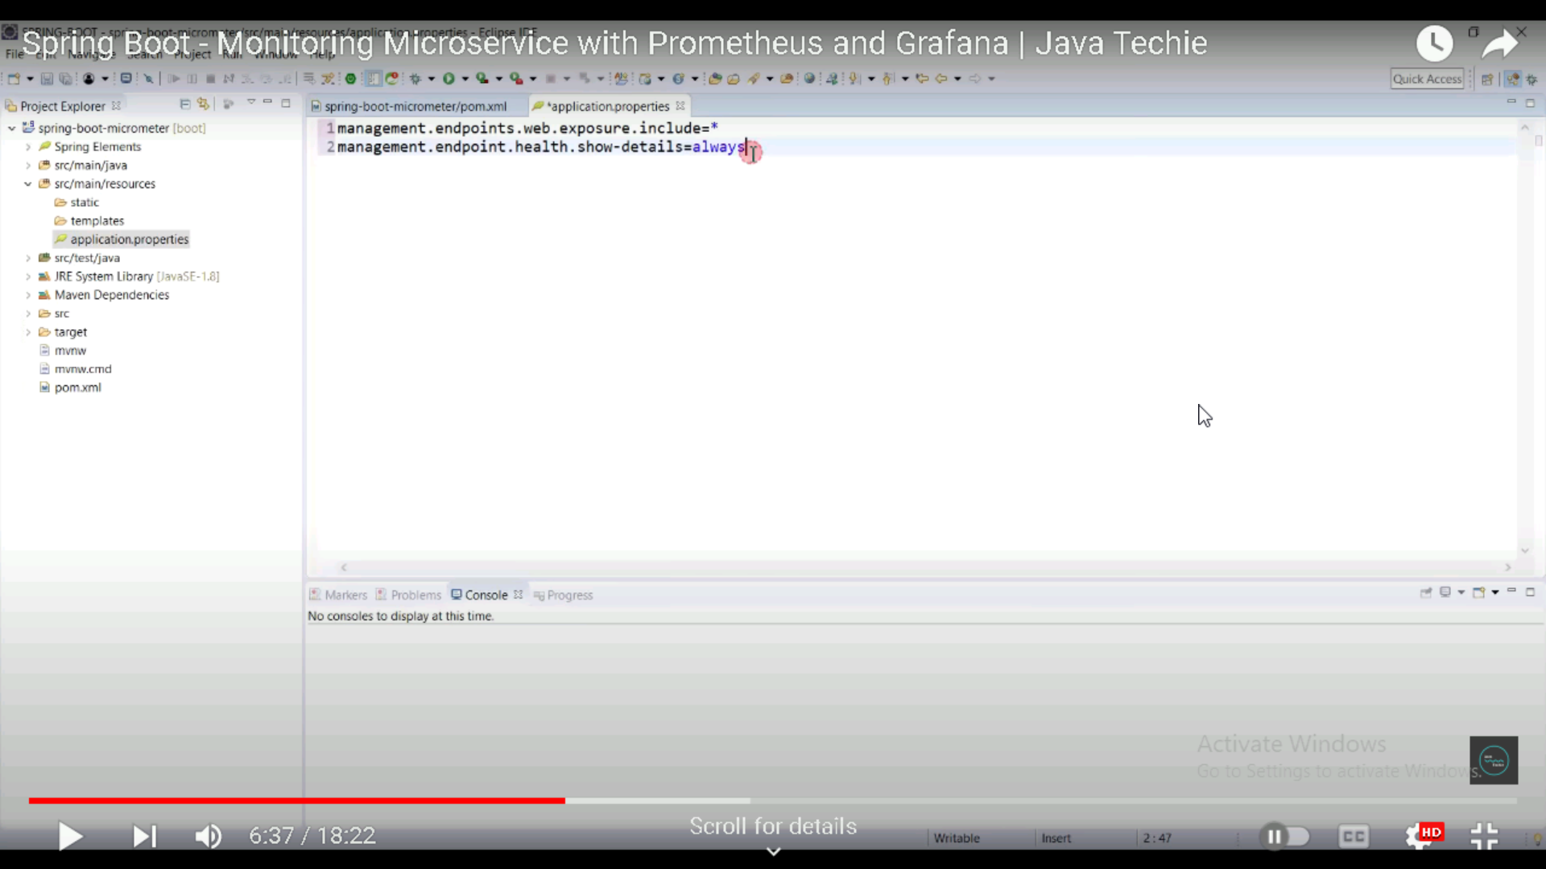

Slide 10
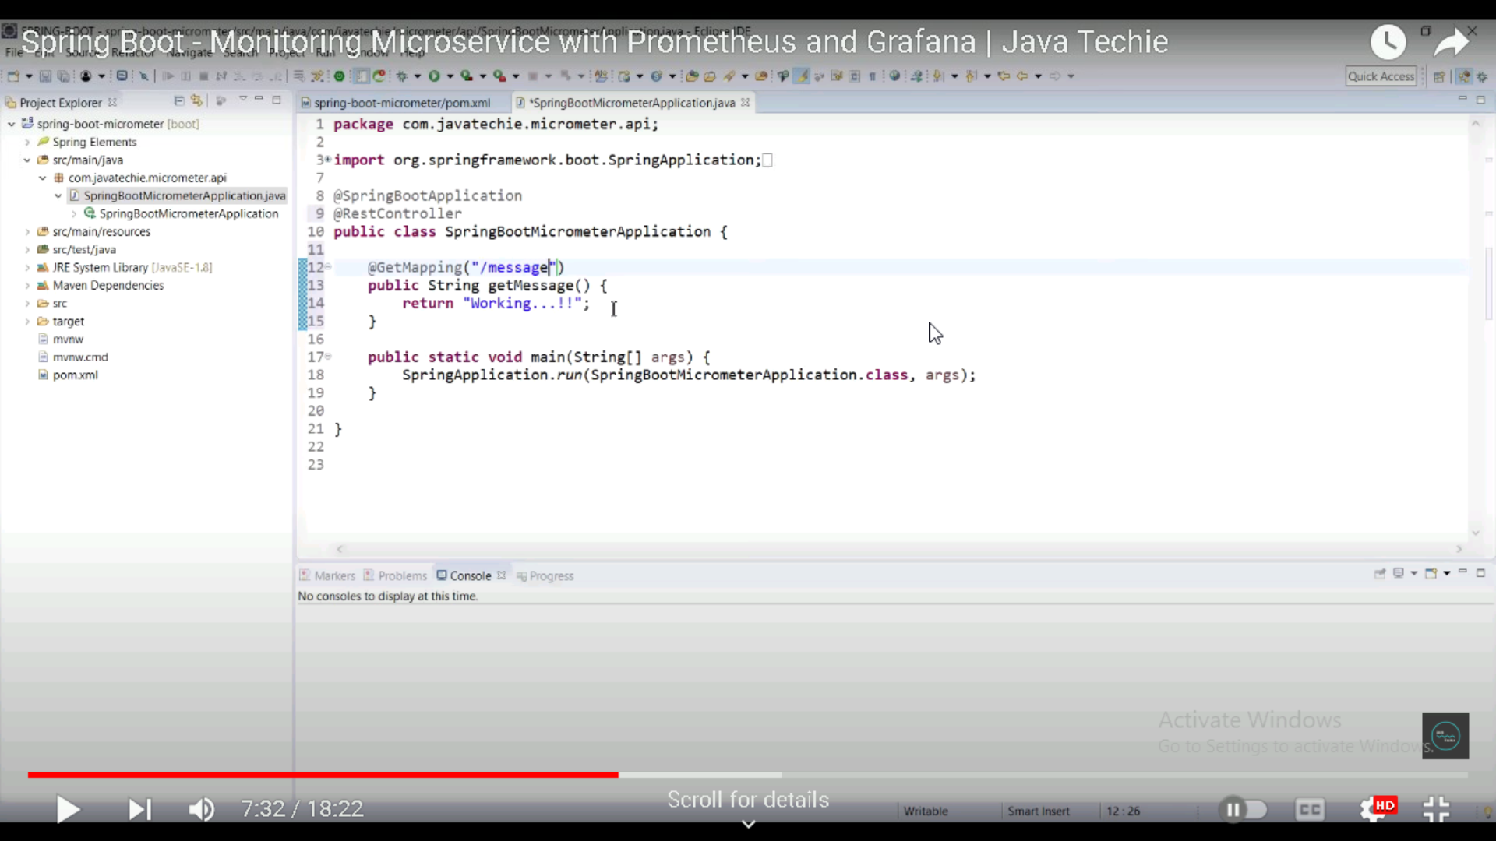

Slide 11
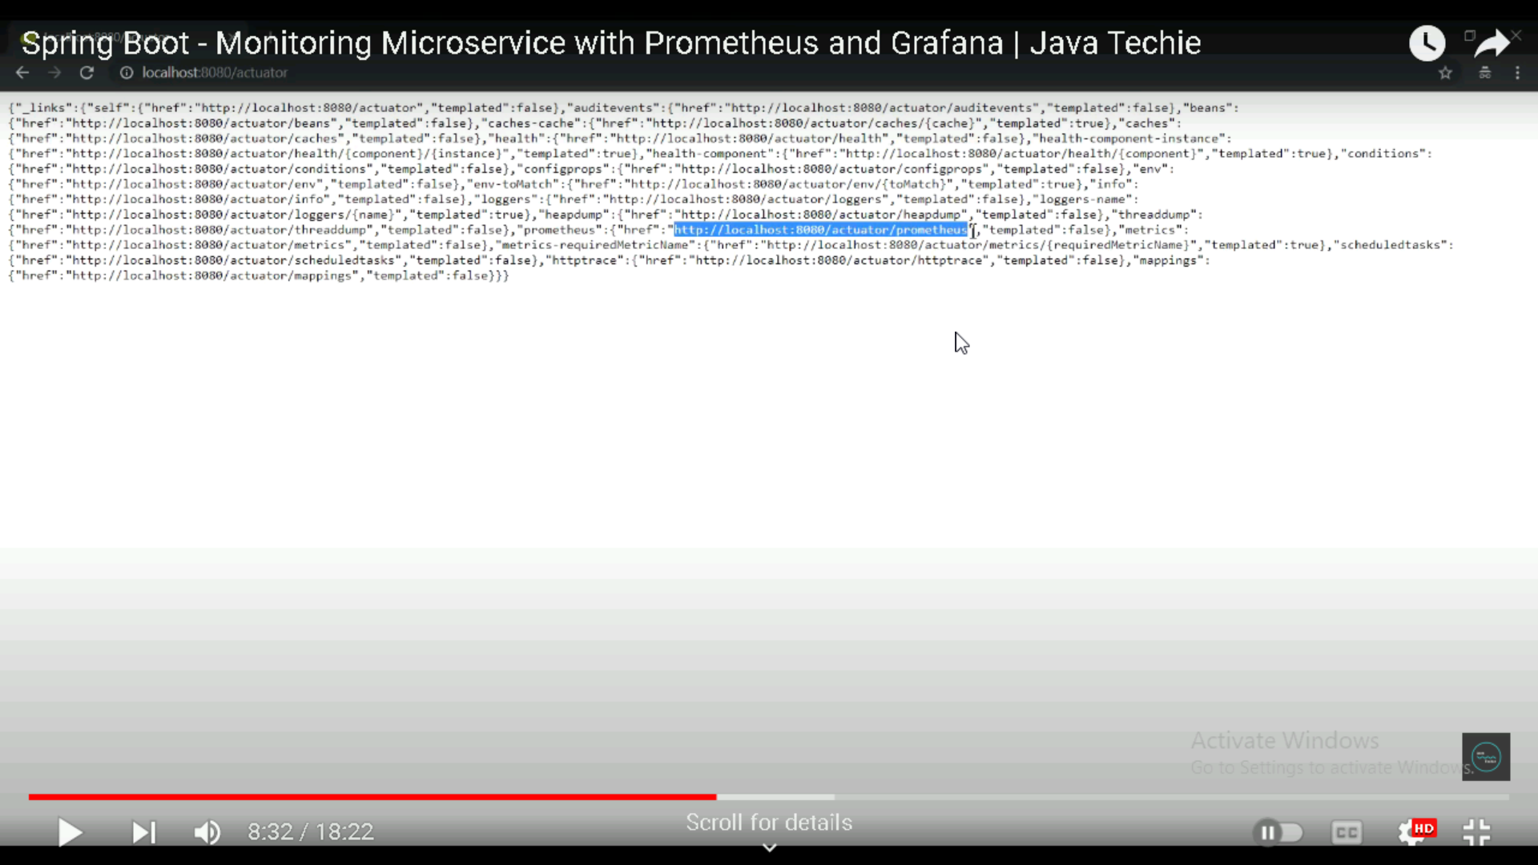

Slide 12
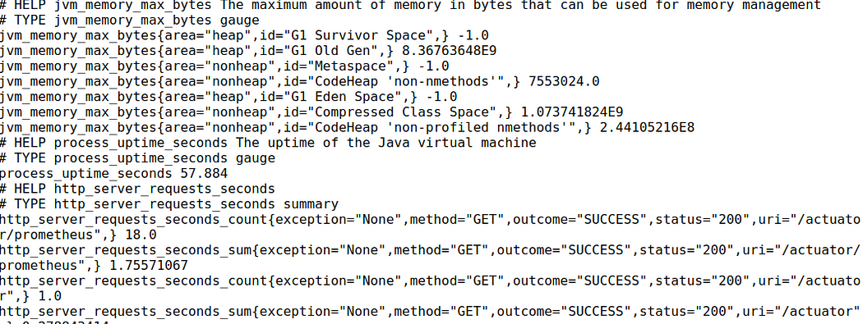

Slide 13
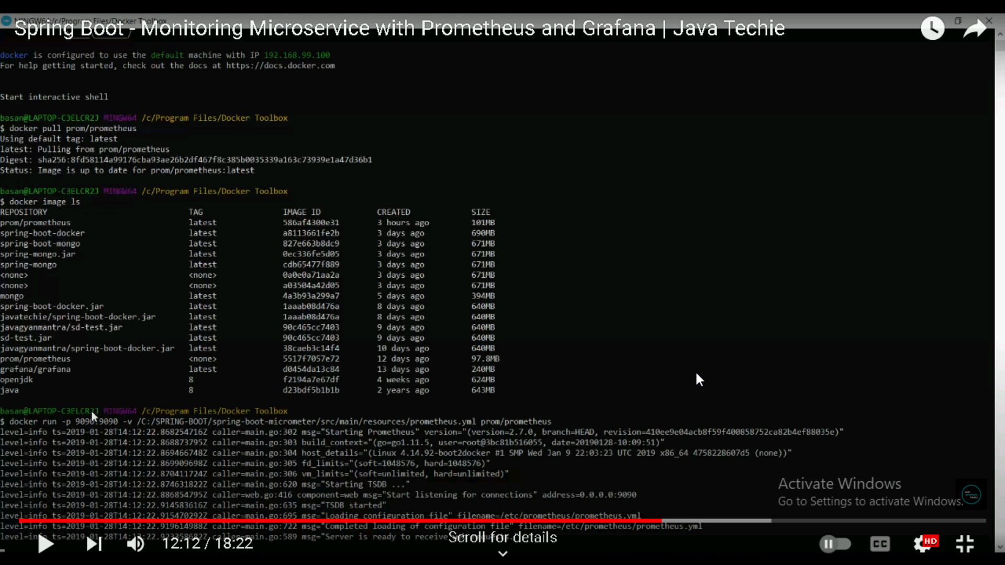

Slide 14
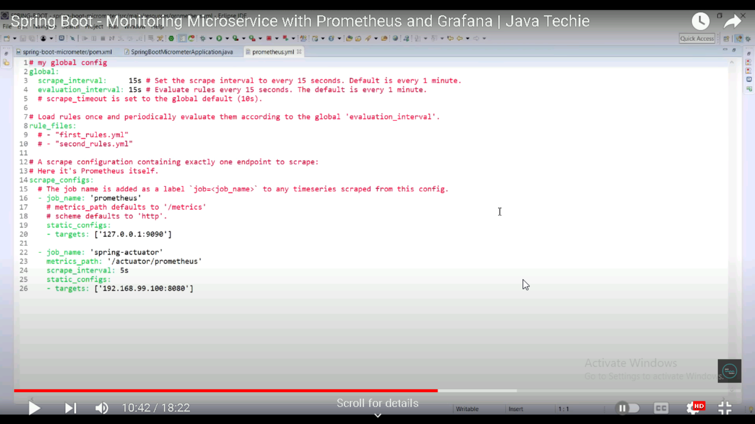

Slide 15
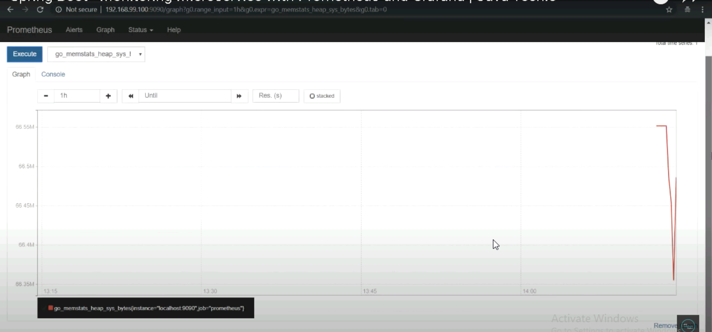

Slide 16
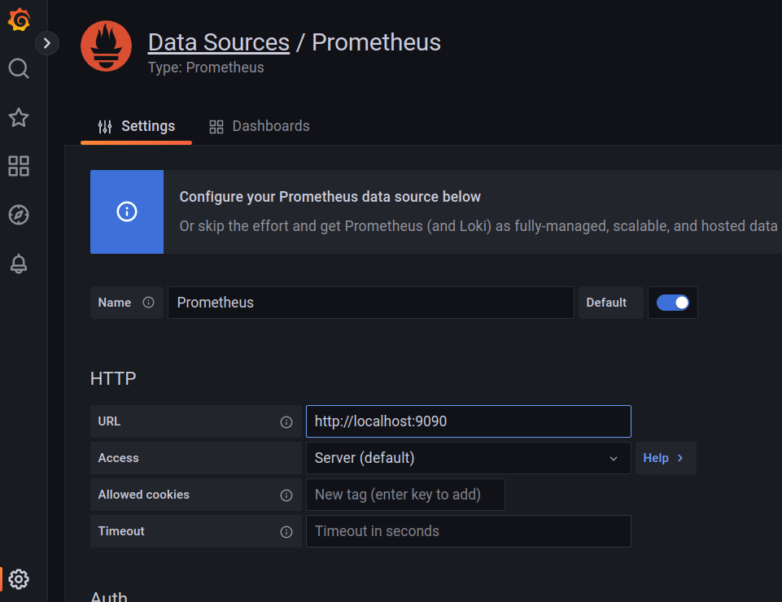

Slide 17
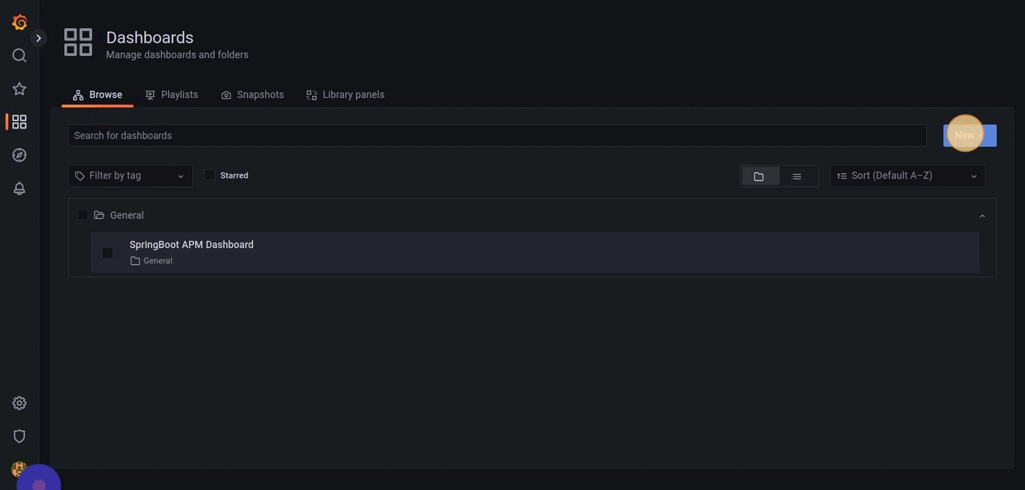

Slide 18
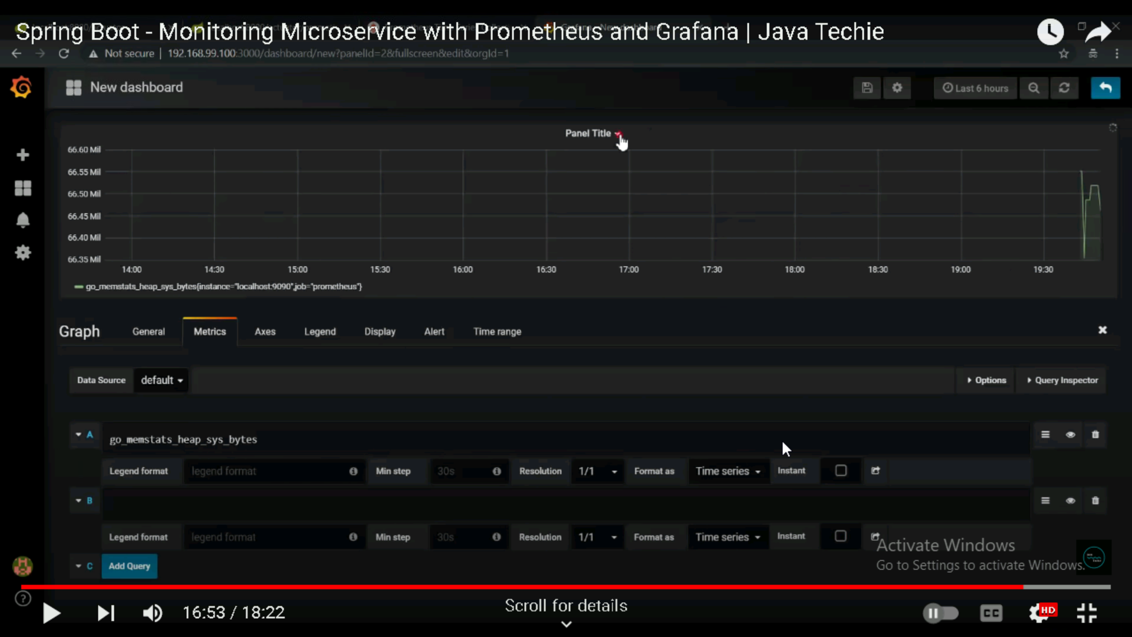

Slide 19
References
Github repository link- MJHAWK21/Spring-boot-with-prometheus-and-grafana (github.com)

